Slide 1

Trend Forecasting for Citi Bike
Professor Jongwook Woo
Group Member Chou-I Cheong
Ying Ying Lai
Zi Xiao Fu

Slide 2
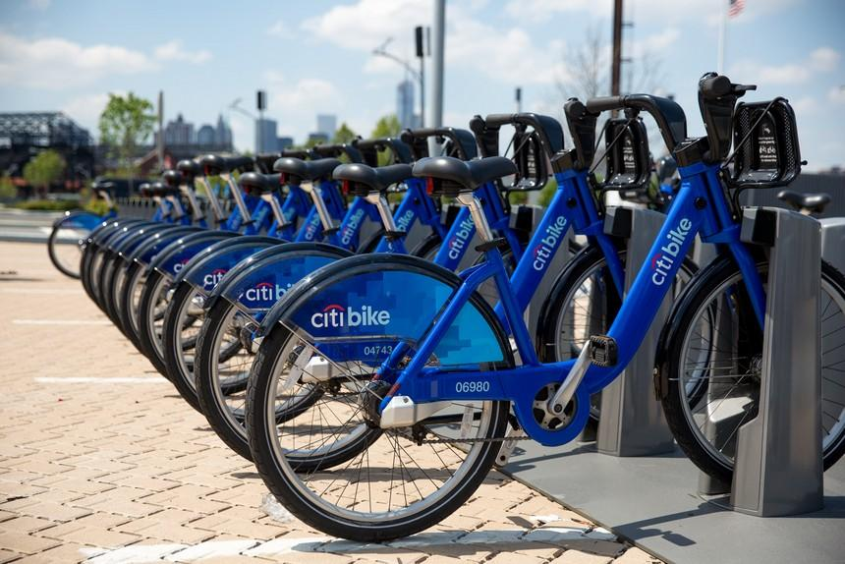
Overview
Citi Bike is a privately owned public bicycle sharing system
Largest bike sharing program in the United States
10,000 bikes & 600 stations
Serves New York City
Save money
Save time
Get exercise
Go green

Slide 3
What we want to know?
Why we want to know?
The trip duration of Citi Bike’s usage of prospective customer.
Which bike station has the most traffic volume. (most popular bike station)
Tailor company’s marketing campaign accordingly
Strategize membership plan accordingly

Slide 4
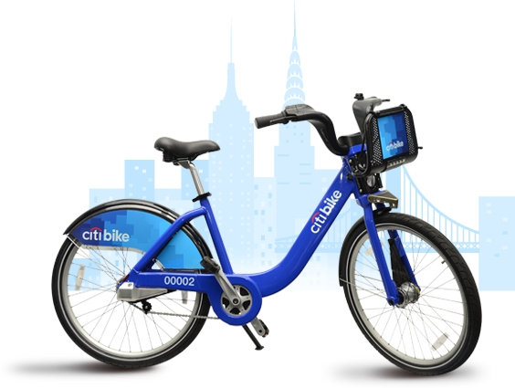
How can we find answers?
Through Regression & Clustering algorithm
Linear Regression
GBT Regression
K Means Clustering
Bisecting K Means Clustering

Slide 5
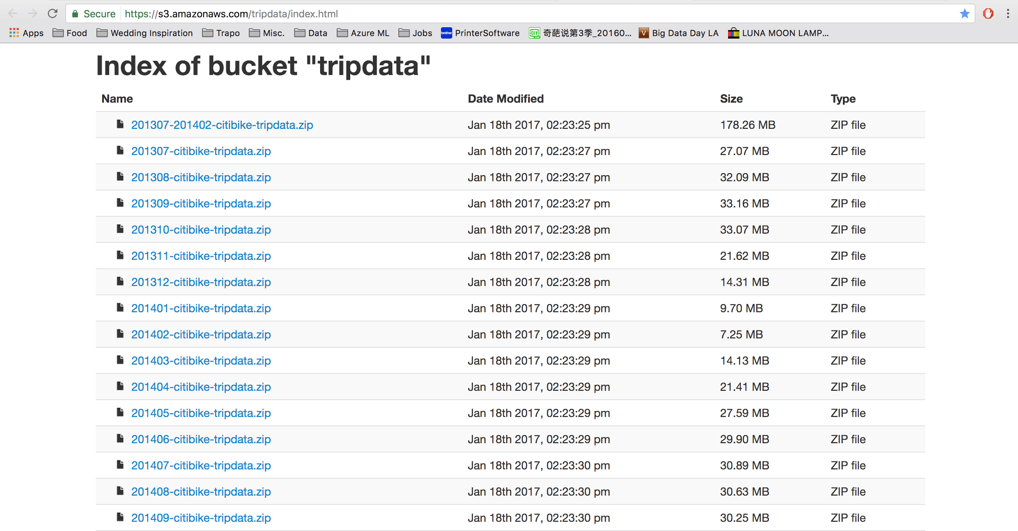
Data Source
https://www.citibikenyc.com/system-data

Slide 6
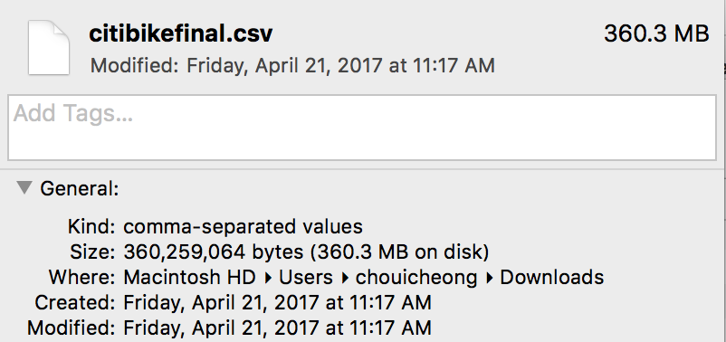
H/W Experimental Specifications
Apache Spark Version - Spark 2.1 (Auto-updating Scala 2.10)
Memory - 6GB Memory, 0.88 Cores, 1 DBU, 1 Drivers
File System - Databricks File System (DBFS)
Data Size - 360.3MB

Slide 7
Part 1
Regression

Slide 8
Work Flow
Dataset Searching
Azure ML
Dataset Cleaning
Spark ML
Algorithm Selection
Algorithm Comparison

Slide 9
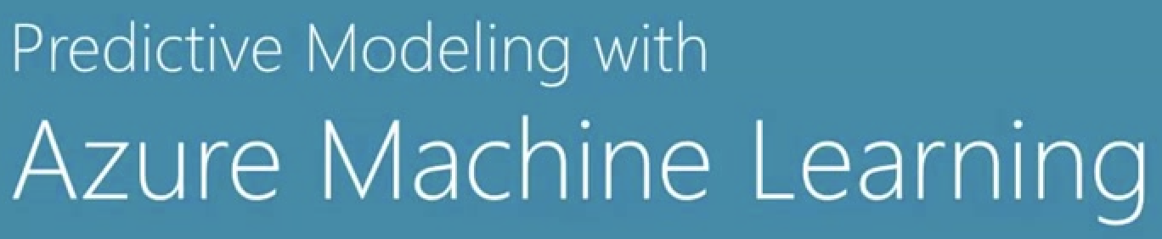
Import DataSet
Select Column
Clean Missing Value
Split Data
Linear Regression/ Two-Class Decision Tree
Train Model
Score Model
Permutation Feature Importance
Evaluate Model

Slide 10
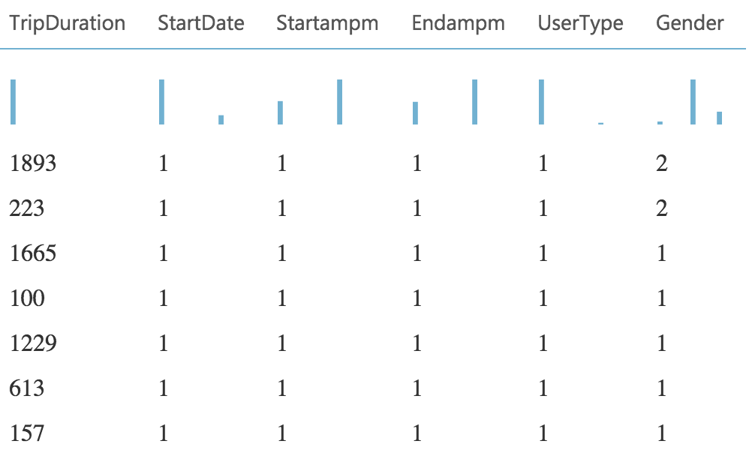
Feature Selection
Trip Duration (in seconds)
Start Date
Start ampm
End ampm
User Type
Gender

Slide 11
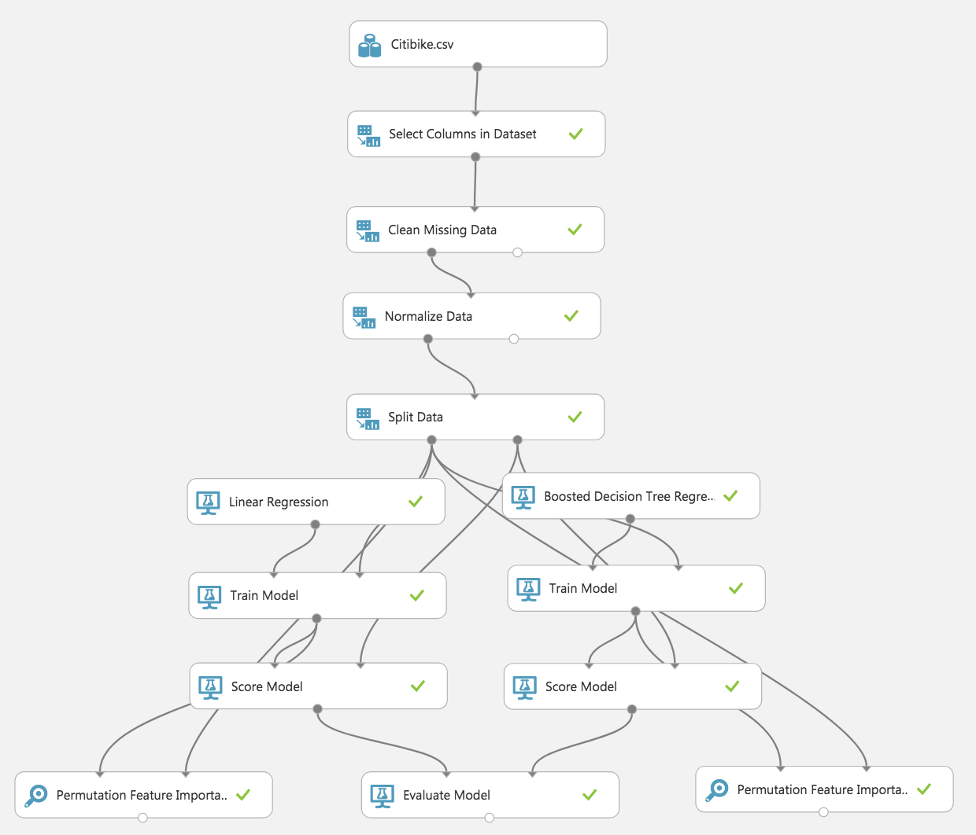
Replace missing values to zero
Normalize using Z score
0.7 for Train
0.3 for Test

Slide 12
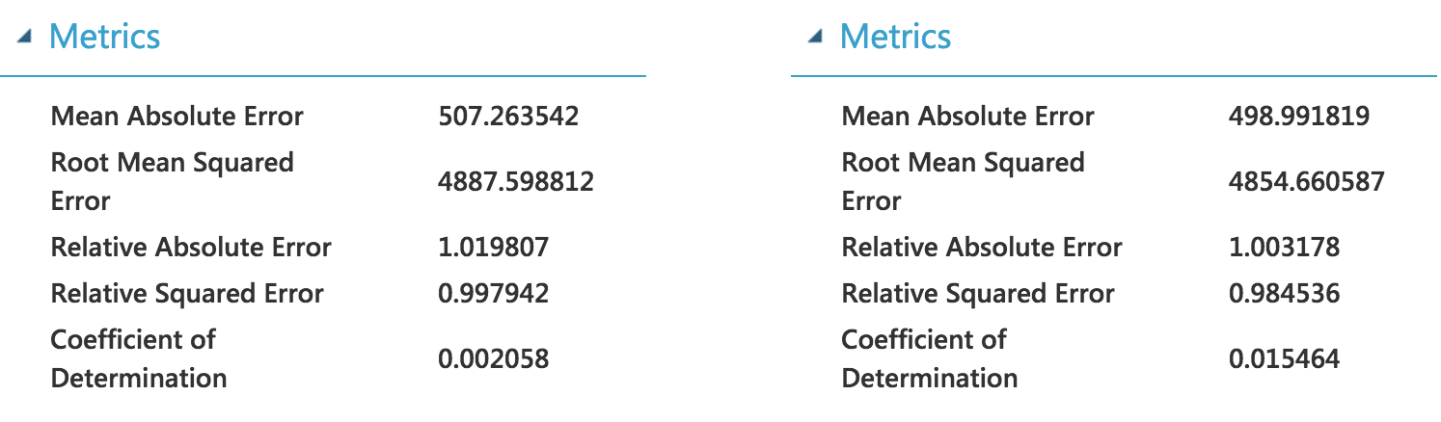
Linear Regression
Boosted Decision Tree

Slide 13
Comparison on Azure ML
 | Linear Regression | Boosted Decision Tree
RMSE | 4887.59 | 4854.66

Slide 14

Spark ML: Linear/GBT Regression
Load the data Source
Select the columns
Split the data
Define a pipeline
Train the Model
Evaluate Model

Slide 15
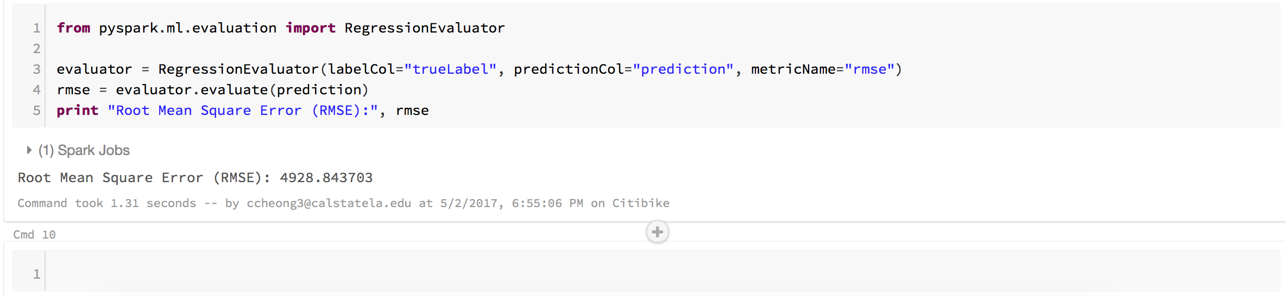
Spark ML
Linear Regression (Cross Validation)

Slide 16
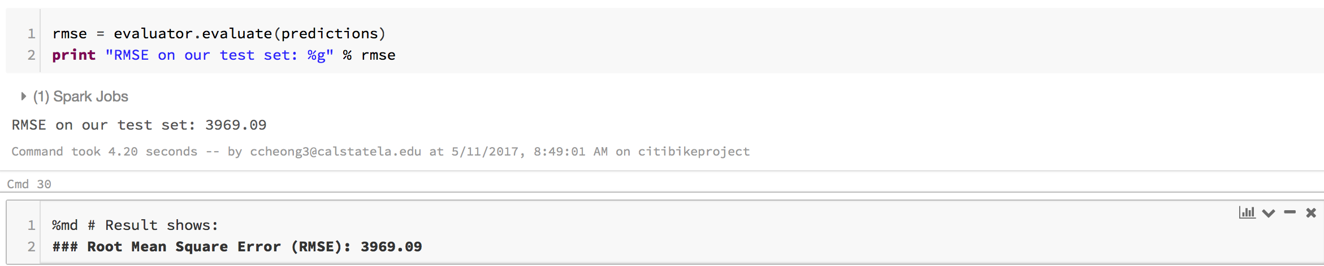
Spark ML
GBT Regression (Cross Validation)

Slide 17
Comparison on Spark ML
 | Linear Regression | GBT Regression
RMSE | 4928.84 | 3969.09

Slide 18
Combined Comparison: Azure ML vs. Spark ML
 | Azure ML |  | Spark ML
 | Linear Regression | Boosted Decision Tree | Linear Regression | GBT Regression
RMSE | 4887.59 | 4854.66 | 4928.84 | 3969.09 (1 hr)
Min is 61 (1 min), Max is 1,089,983 (302 hrs)
RMSE of 3969.09 (1 hr) is negligible

Slide 19
Observation
The dataset contains a huge amount of rows, ie: 2.4 million rows
It is very challenging when we want to make sure data type is consistent.
Azure ML do not have GBT regression model, and Spark ML do not Have Boosted Decision Tree function.
It all depends on data size, data quality, and nature of data.

Slide 20
Model Suggestion
GBT Regression
in Spark ML

Slide 21
Part 2
Clustering

Slide 22


New York Citi bike Clustering Analysis

Slide 23
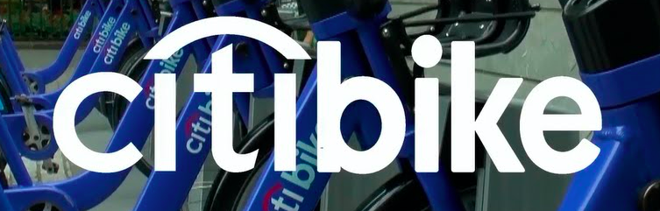
Clustering Bike Station
Objectives:
Using two different clustering algorithm to cluster the location data of the bike station, segment the data in a geographic-visualized chart.
The result can help the New York Citi Bike Company to analysis the popularity of the bike station, predict the traffic stream and adjust the distribution amount of the bike for different stations.

Slide 24
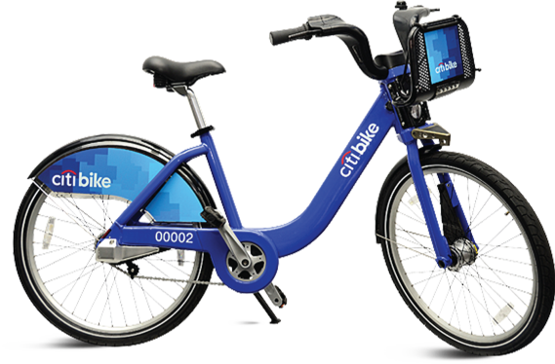
Algorithm Used: Clustering
K-Means clustering model
K-Means
Bisecting k-means

Slide 25
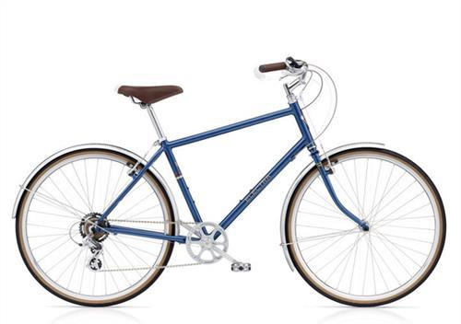
K-means
Features
- Clustering the data points into a predefined number of clusters.
Random choice of initial cluster centers
Advantages
Easy to achieve
Disadvantages
Random choice of initial cluster centers may cause local minimum cluster
Processing speed is slow when clustering large scale of data

Slide 26
Bisecting k-means
Features
-A kind of hierarchical clustering -Using a divisive (or “top-down”) approach :
All observations start in one cluster ,and splits are performed recursively as one moves down the hierarchy
Advantages
- Often be much faster than regular K-means
- Local minimum cluster will not happen in this algorithm

Slide 27
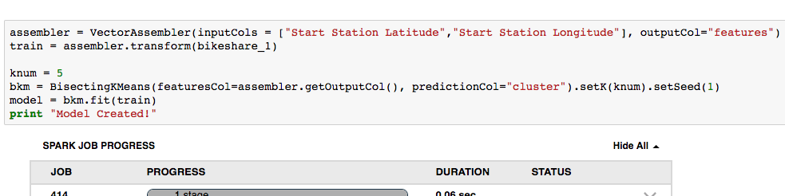
Lab tutorial for Bisecting k-means
Step 1: Create the K-Means Model
Use the features in the geography data to create a Kn-Means model with a k value of 5. This will be used to generate 5 clusters.

Slide 28
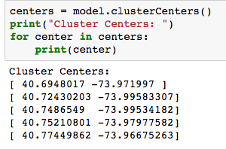
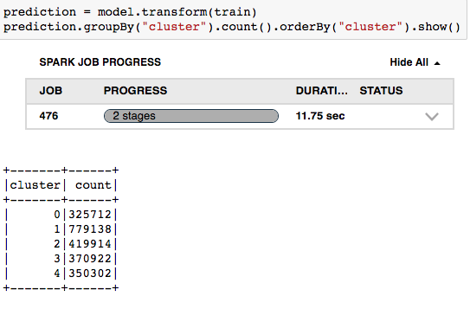
Lab tutorial for Bisecting k-means
Step 2: Get the Cluster Centers
Step 3: Predict Clusters

Slide 29
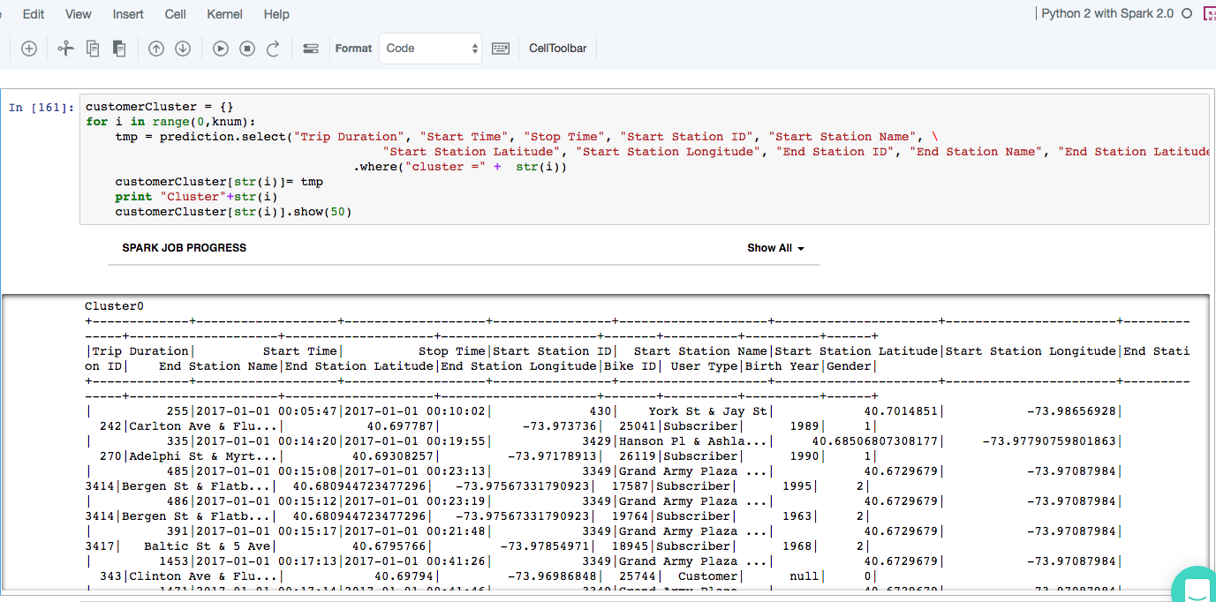
Lab tutorial for Bisecting k-means
Step 4: Check the cluster information

Slide 30
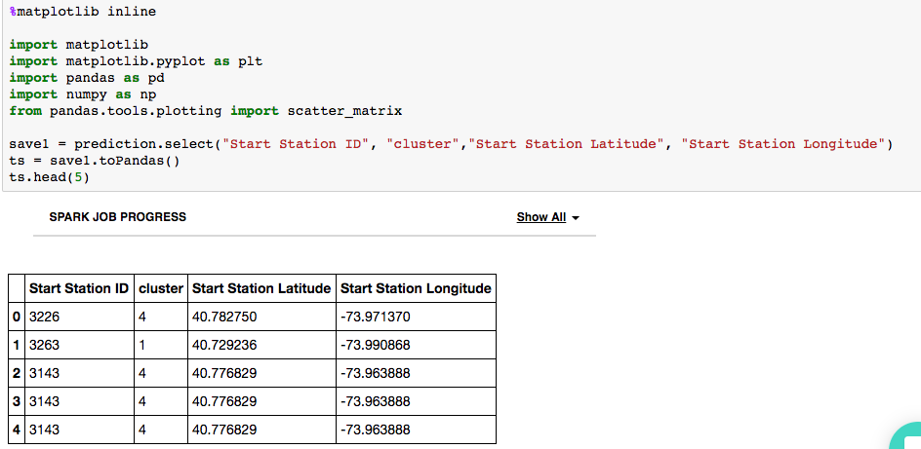
Lab tutorial for Bisecting k-means
Step 5: Using two steps of python code to visualize the clustering results into a Scatter diagram.

Slide 31
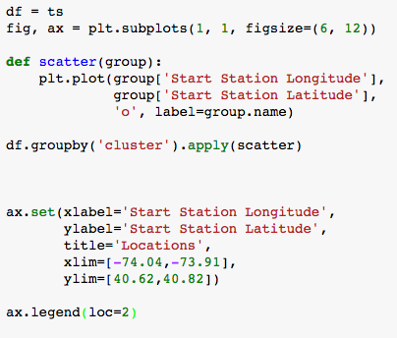
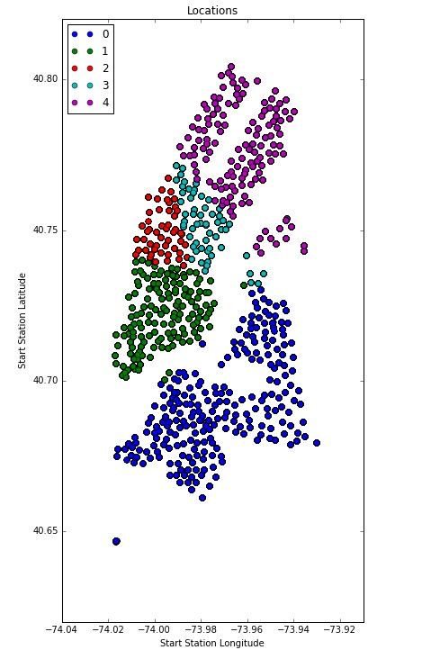
Lab tutorial for Bisecting k-means

Slide 32
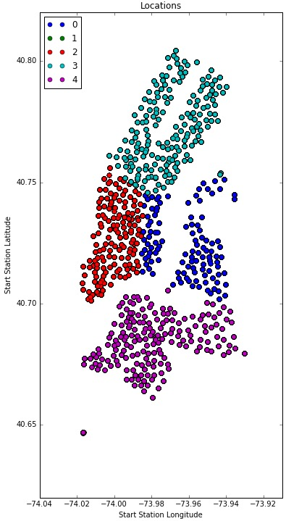
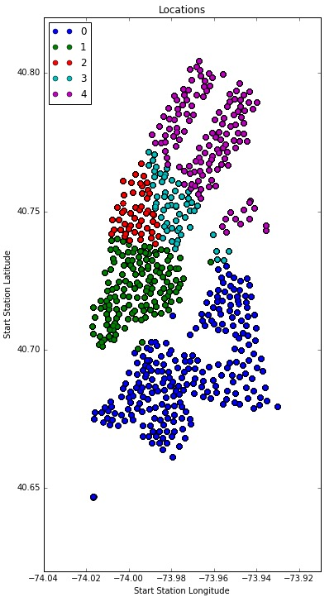
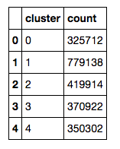
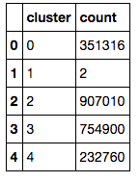
Experiment Results —
K-means VS Bisecting k-means
K-means
Bisecting k-means

Slide 33
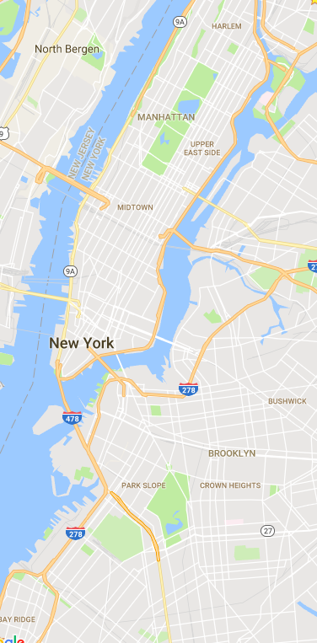
Application
New York Local Map

Slide 34
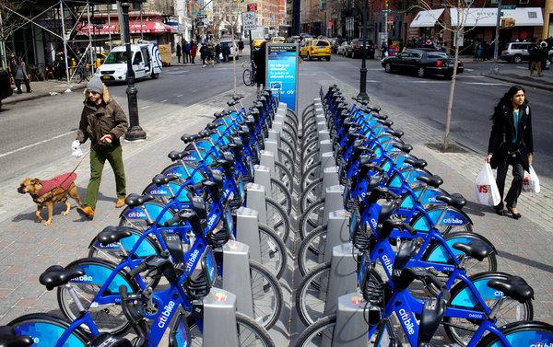
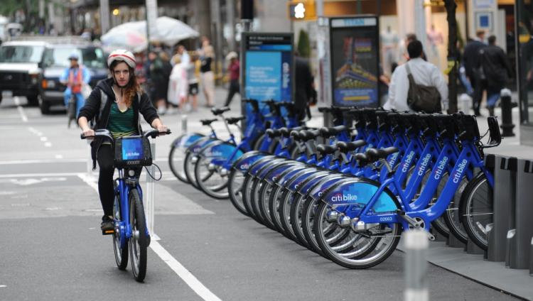

Summary
Those two algorithm produce two totally different clusters.
One local minimum cluster appears in the K-means algorithm which is not representative and grossly misunderstood.
Bisecting k-means is more suitable for this project.

Slide 35
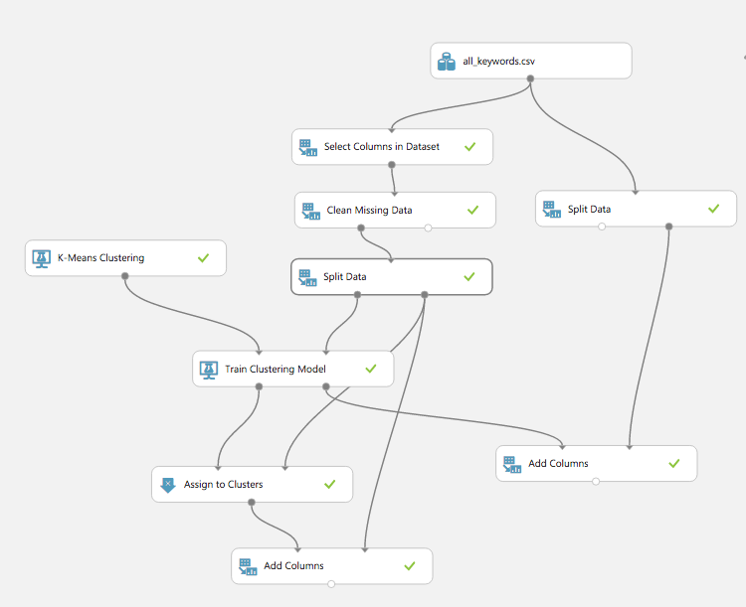
K-Means Clustering Model in Azure ML

Slide 36
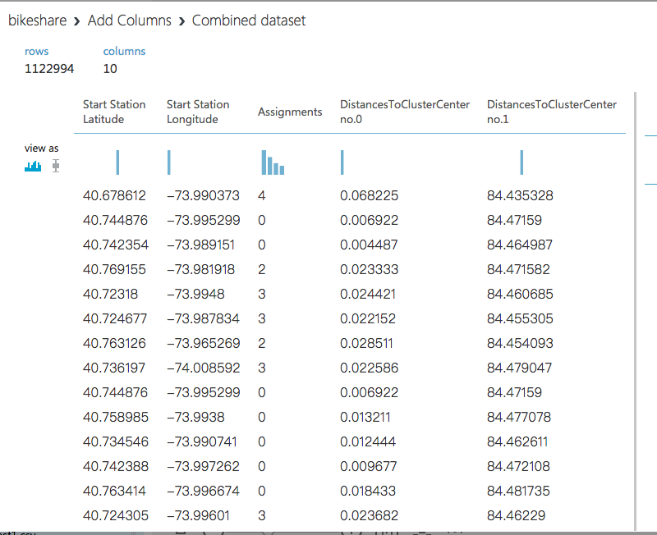
Clustering in Azure ML — Results

Slide 37
Reference
Algorithm code learning: http://spark.apache.org/docs/latest/ml-clustering.html#bisecting-k-means
Professor Woo,Jongwook course slides, Chapter 13 - Spark ML Unsupervised

Slide 38
GitHub
https://github.com/yingyinglai/citibike

Slide 39
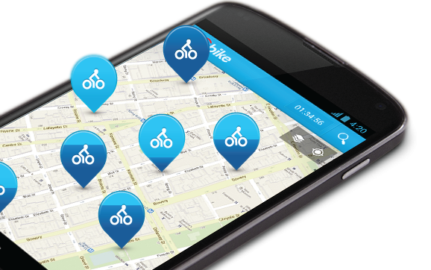

Thanks for watching!
Q&A Time

